Slide 1

Instrumentation and Control
CSE 325
"You cannot teach a man anything, you can only help him to find it for himself.”
-Galileo Galilei
Mehedi Hasan
Lecturer
Computer Science and Engineering(CSE)
Daffodil International University(DIU)

Slide 2
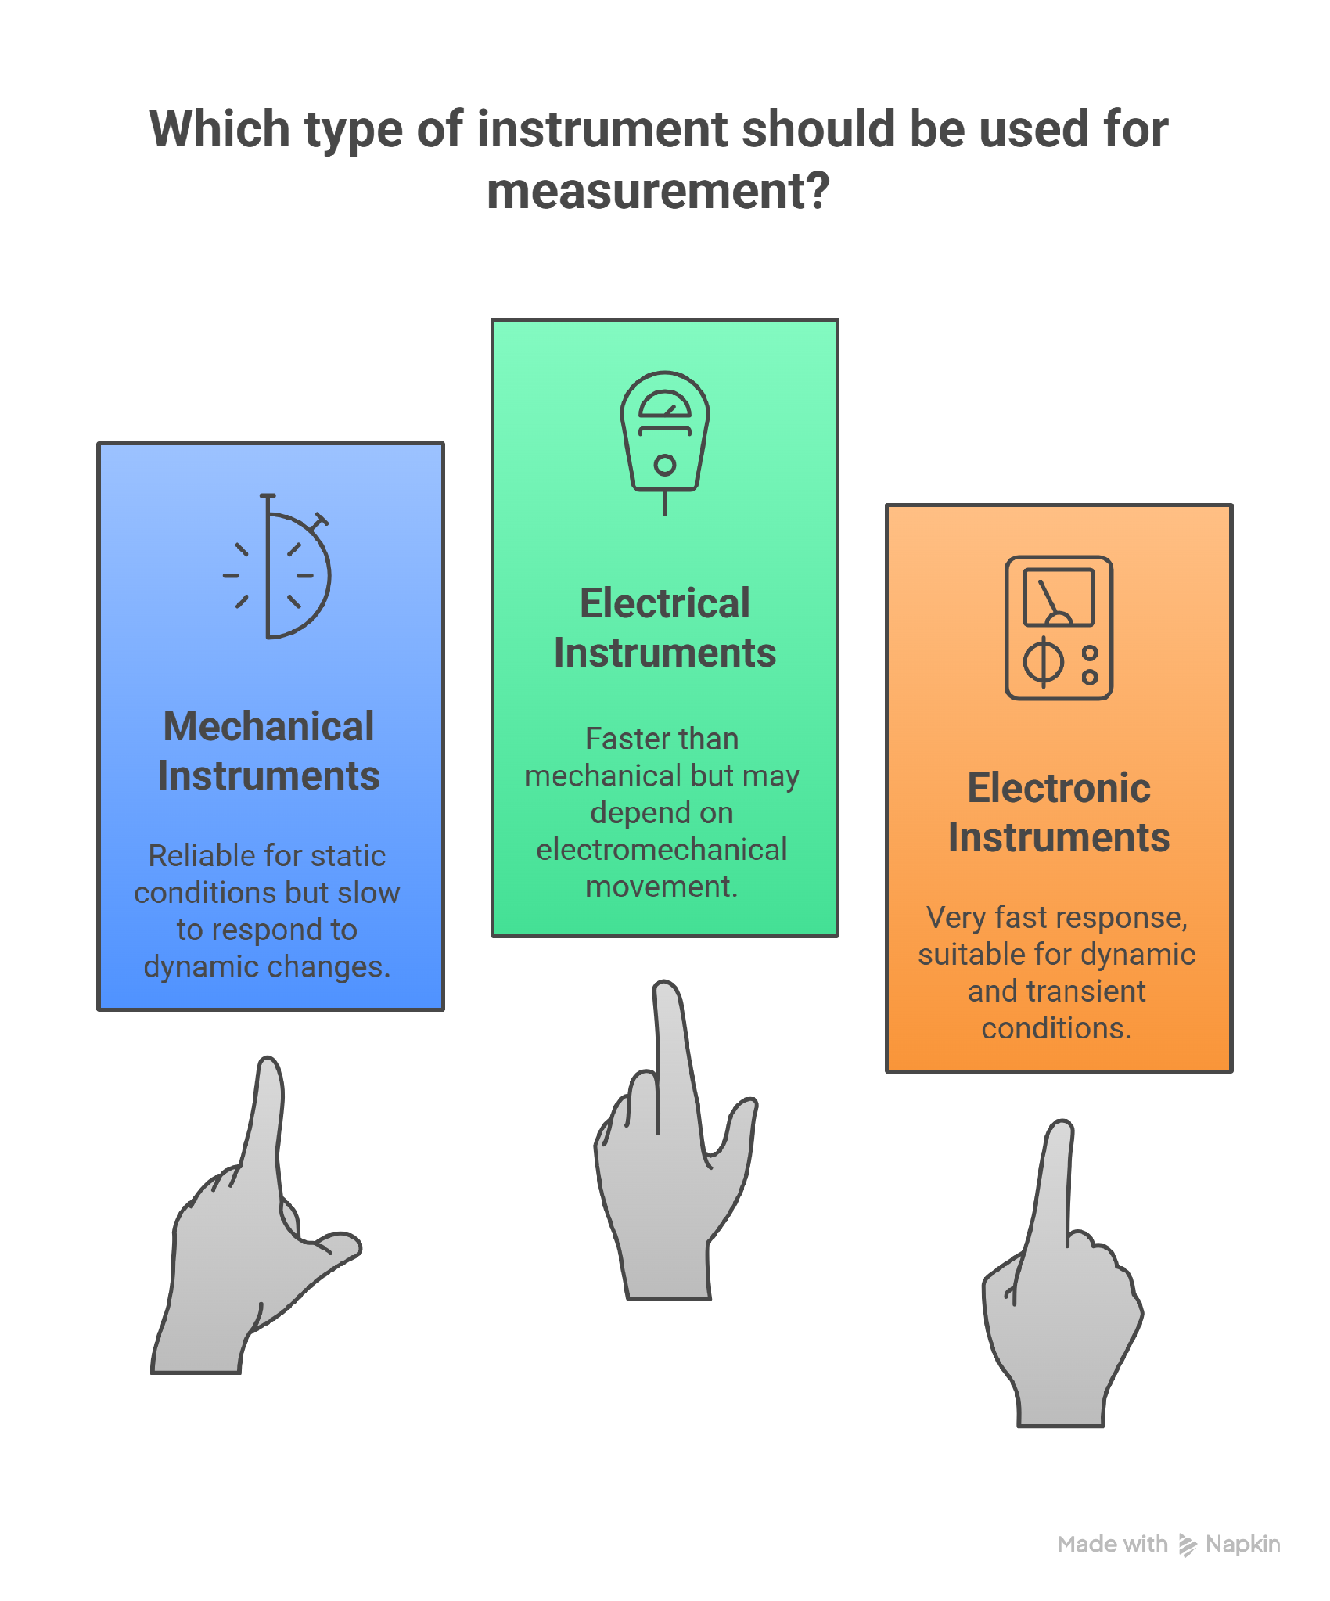
Classifications of Instruments
Basic classification:
1. Mechanical instruments- They are very reliable for static and stable conditions.
Disadvantage: unable to respond rapidly to measurement of dynamic and transient conditions.
2. Electrical instruments- This method is more rapid than mechanical methods. They normally depends upon an electro-mechanical meter movement
3. Electronic instruments:- Have very fast response.
e.g., cathode ray oscilloscope (CRO) is capable to follow dynamic and transient changes of the order of few nanoseconds (10⁻⁹s).

Slide 3
Classifications of Instruments
classification is based on the various effects of electricity:
• Magnetic effect: Used in deflection-type ammeters, voltmeters, watt- meters etc.
• Heating effect: Used in ammeters and voltmeters
• Chemical effect: Used in dc ampere hour meters
• Electrostatic effect: Used in voltmeters
• Electromagnetic induction effect: Used in ac ammeters, voltmeters, wattmeters.
Classification based on the kind of current that can be measured:
• Direct current (dc) instruments
• Alternating current (ac) instruments
• Both direct current and alternating current instruments
(dc/ac instruments).

Slide 4
Classifications of Instruments
Classification based on the Nature of their Operations
• Indicating instruments: Indicated by means of a mechanical pointer which moves on a scale, or digital display. e.g., ammeter, voltmeter, wattmeter
• Recording instruments: Record continuously the variation of any electrical quantity with respect to time.
• Integrating instruments: Record the consumption of the total quantity of electricity, energy etc., during a particular period of time. Ampere-hour meter: kilowatthour (kWh) meter

Slide 5
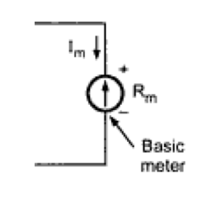
Circuit Symbol of Basic PMMC Meter
Here,
I_{m} = Full-scale deflection current through the basic meter
R_{m} = resistance of the basic meter

Slide 6
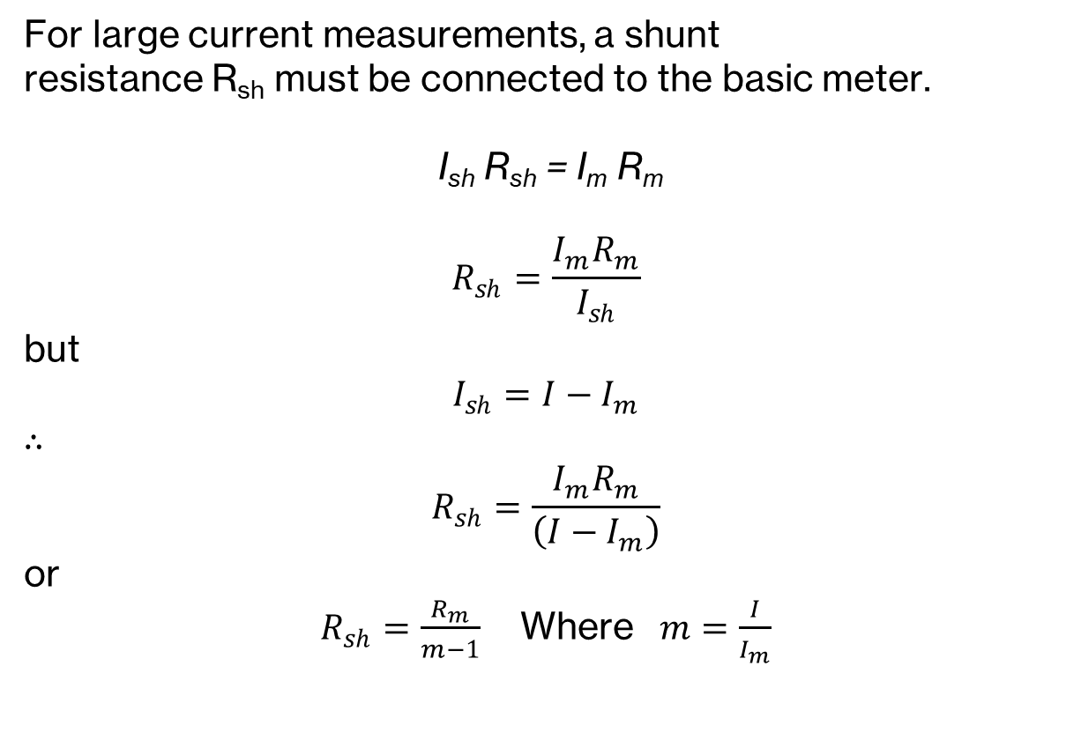
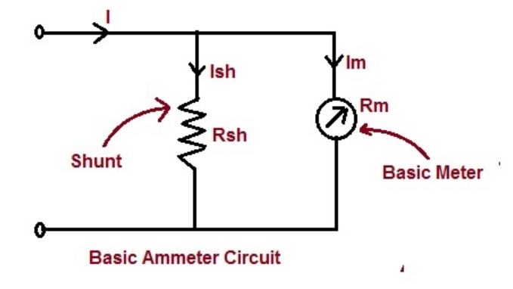
DC PMMC Ammeter

Slide 7

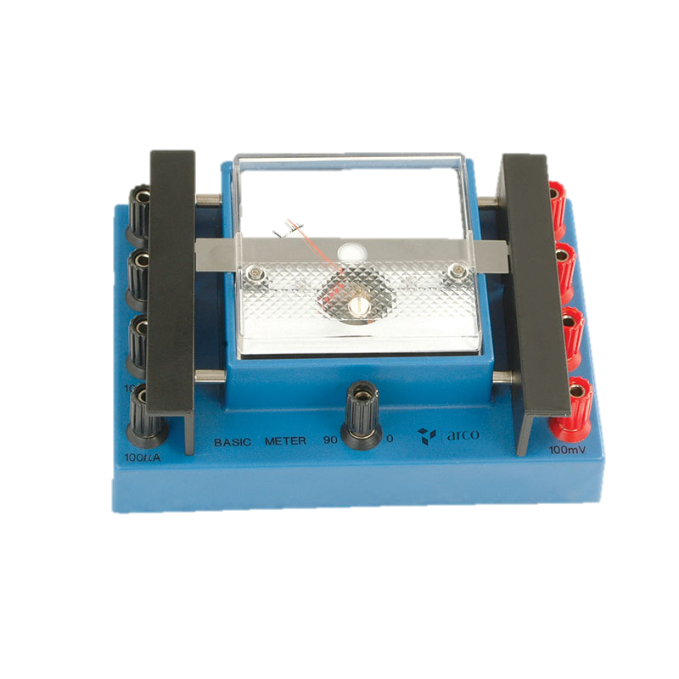
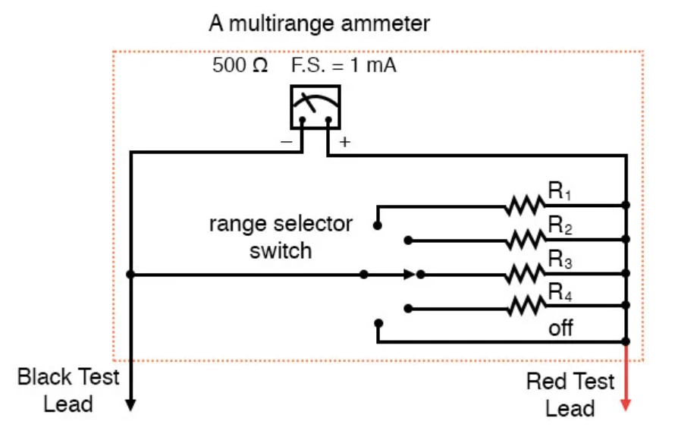
Multirange Ammeter
Multirange Ammeter:
Various values of resistances can be used by means of suitable switching arrangement, to increase the number of current ranges.
Simple arrangement: Shown In the figure.
Disadvantages:
1. During the changeover of switch, the shunt is momentarily removed from the meter. Then, the full current flows through the meter coil. This can damage the coil.
2. The contact resistance of the switch is in series with the shunt. It can be of variable nature. So, the ammeter indication may not be accurate.

Slide 8
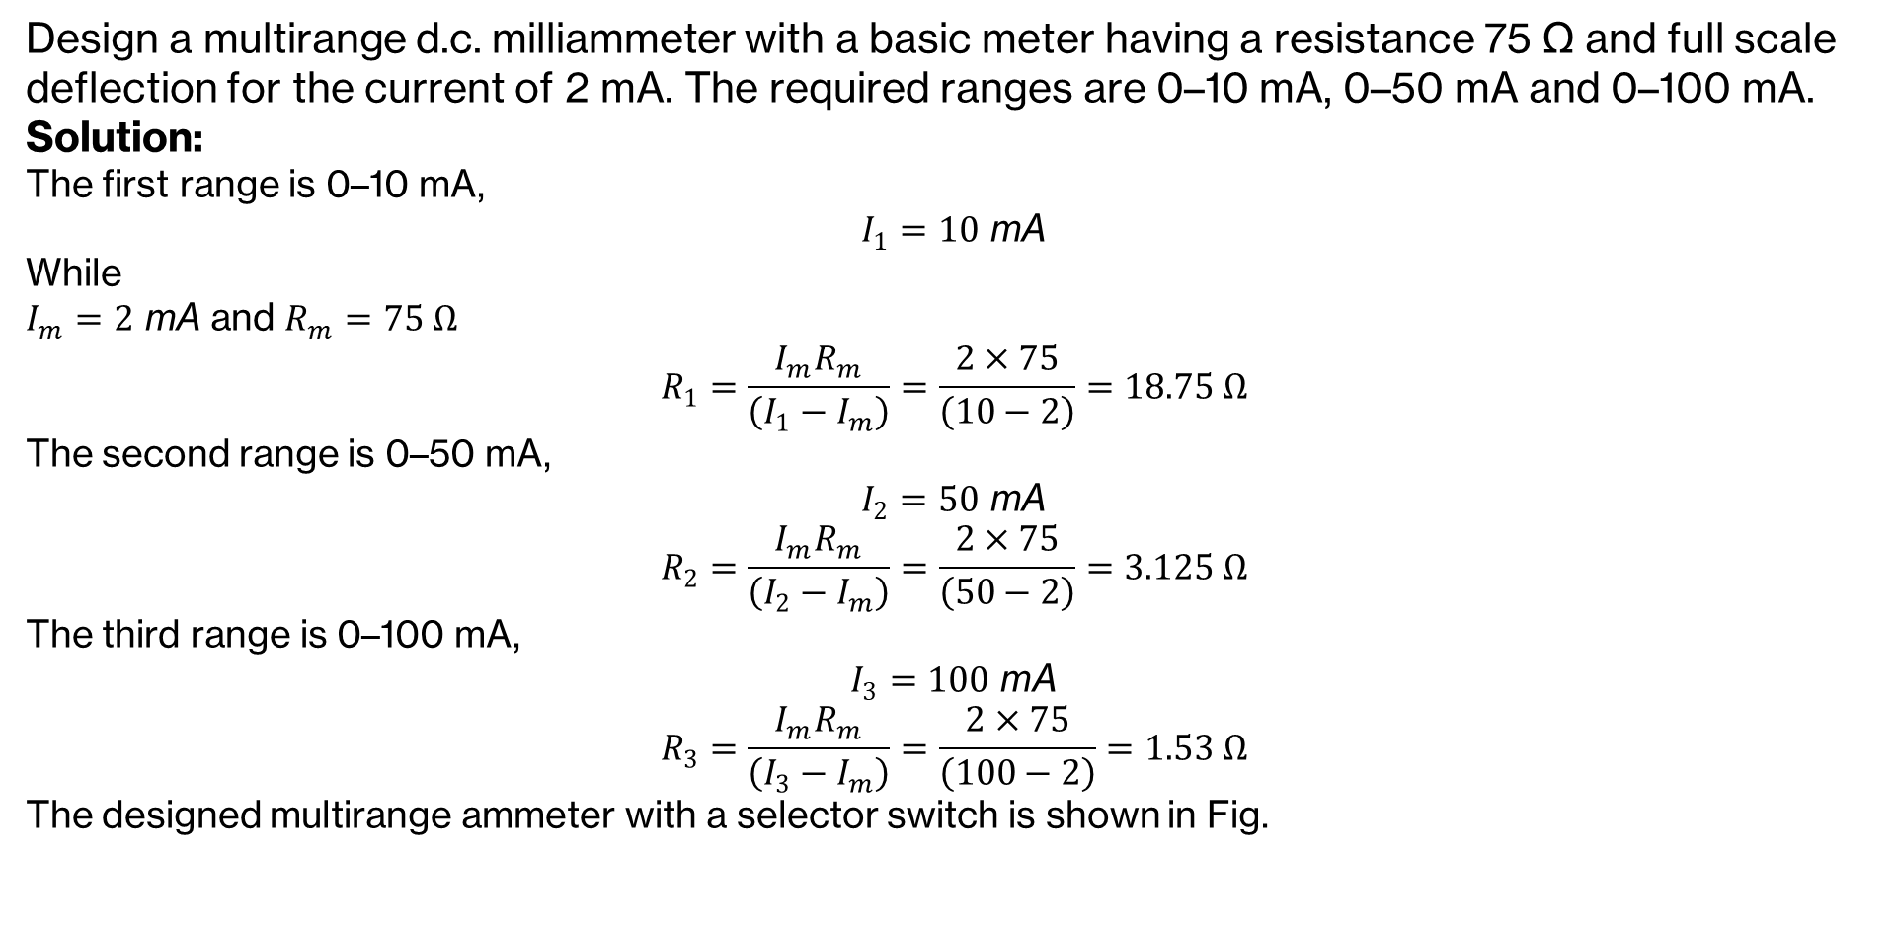
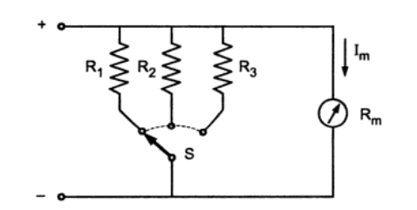
Multirange Ammeter

Slide 9
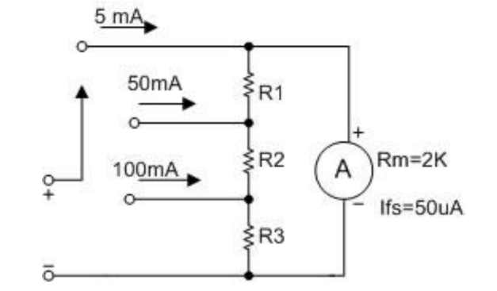
Multirange Ammeter
2. Ayrton Shunt/universal shunt Arrangement:
Eliminates the possibility of momentary disconnection of the shunt.
- The contact resistance of the switch is external to the shunt and meter.

Slide 10
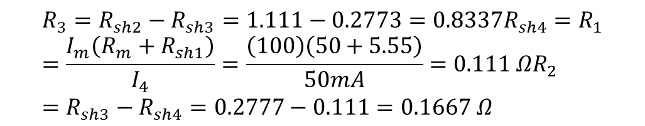
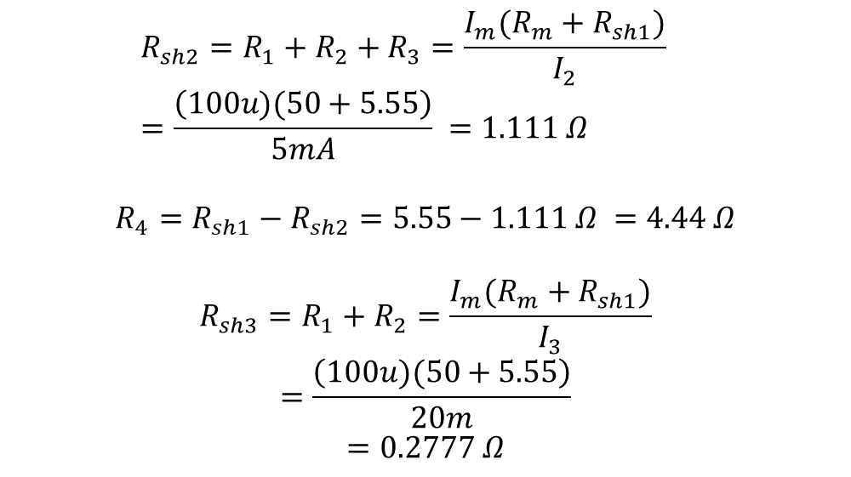
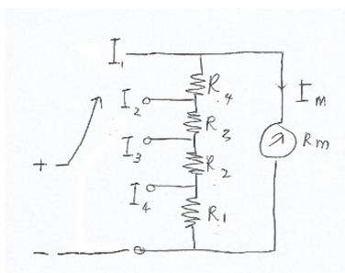
Mathematics
Design an Ayrton shunt to provide an ammeter with current ranges of 0 -1 mA, 5 mA, 20 mA, and 50 mA, using a PMMC meter having internal resistance of 50 Ω and a full-scale current of 100 µA.
To understand this equation see my hand note

Slide 11
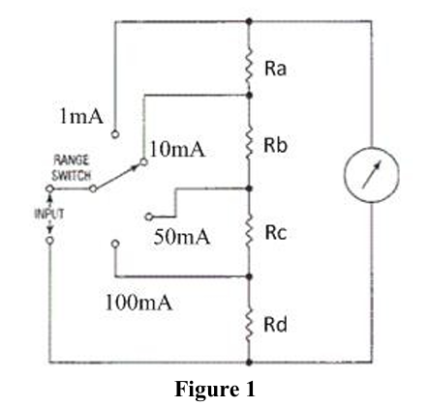

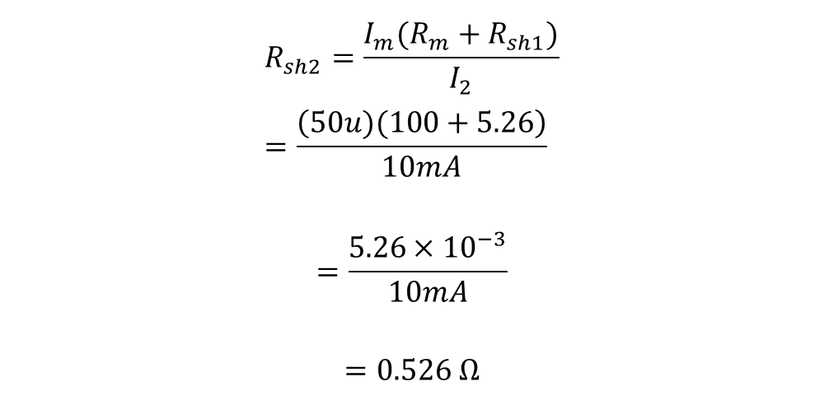

Mathematics
Figure 1 shows an Aryton shunt of an ammeter with a current range of 0 – 1 mA, 10 mA, 50 mA and 100 mA. A PMMC meter movement with an internal resistance of 100 Ω and full-scale current of 50 µA is used. Propose the value of R_{a}, R_{b}, R_{c} and R_{d} for this design.

Slide 12

Mathematics
Figure 1 shows an Aryton shunt of an ammeter with a current range of 0 – 1 mA, 10 mA, 50 mA and 100 mA. A PMMC meter movement with an internal resistance of 100 Ω and full-scale current of 50 µA is used. Propose the value of R_{a}, R_{b}, R_{c} and R_{d} for this design.

Slide 13
Ammeter Loading Effect
If the internal resistance of the meter is a large portion of the load resistance of the circuit under measurement, an effect known as meter-loading occurs.
- Meter loading occurs when the insertion of the meter into the circuit changes the voltage/current values so that circuit. We say that the meter is loading the circuit.

Slide 14
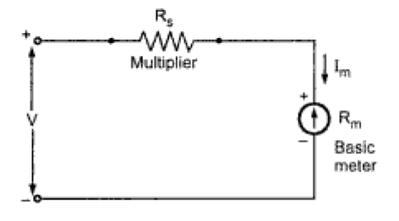
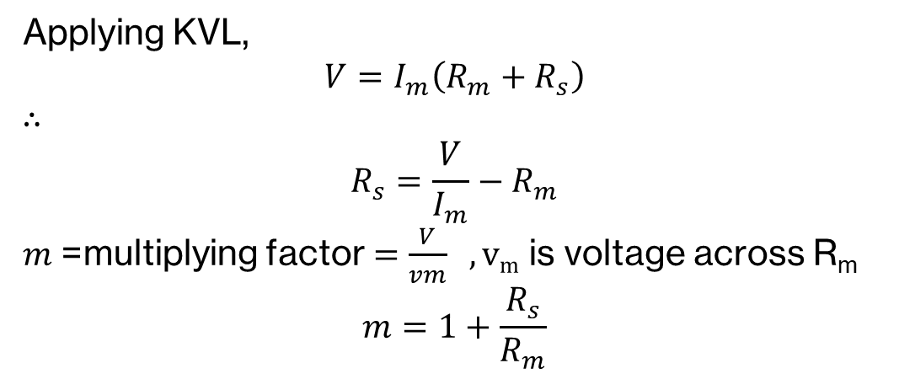
DC PMMC Voltmeter
Let, I_{m} = 1 mA, and R_{m} = 1000 Ω
So, the basic meter can be connected across a maximum of 1 V only.
-To increase the range, resistors (Rs) are connected in series with the basic meter. Sometimes these resistors are called ‘multipliers.
’.For the circuit,

Slide 15
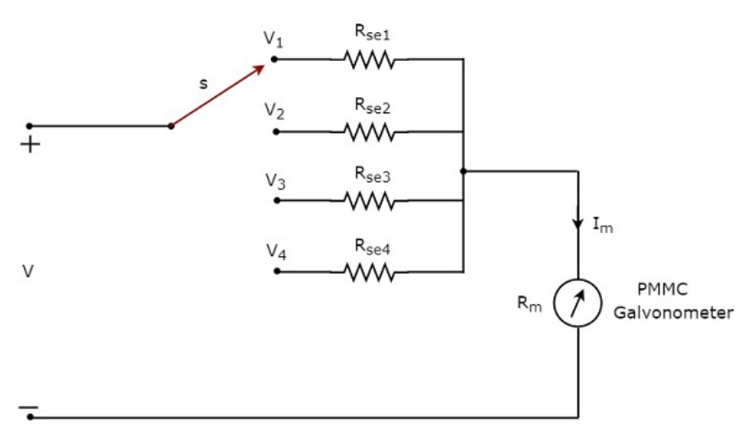
Multirange Voltmeter (Homework)
Ex 02: A 1 mA meter movement with an internal resistance of 50 Ω is to be used in a 0-1 V, 0-10 V, 0-50 V, and 0-100 V ranges in the arrangement shown above. Find the value of the required multiplier resistances.

Slide 16
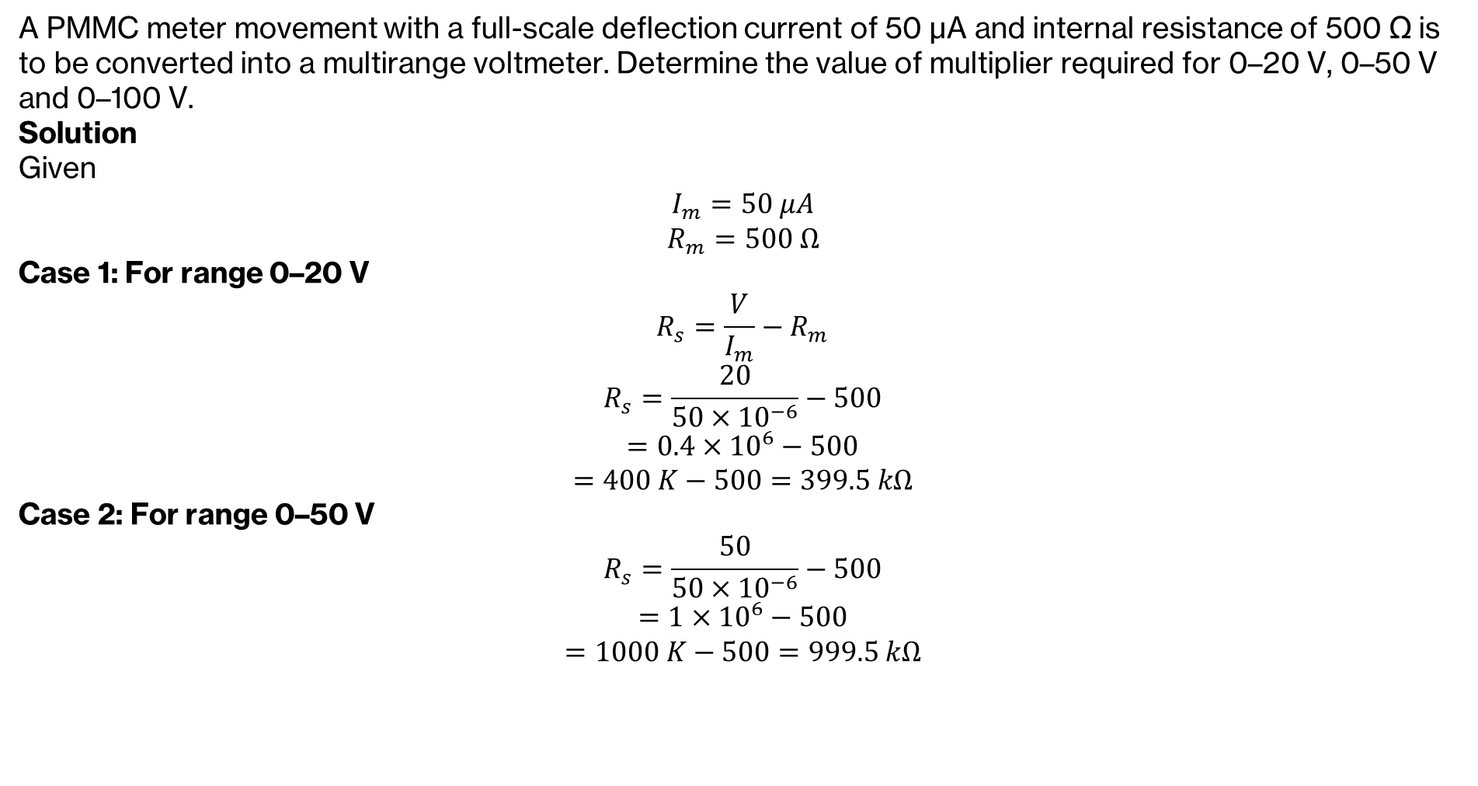

Multirange Voltmeter

Slide 17
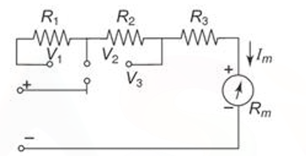
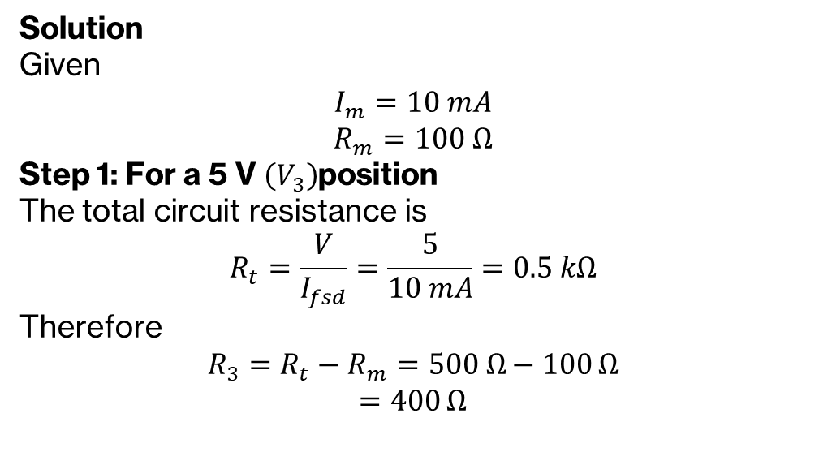
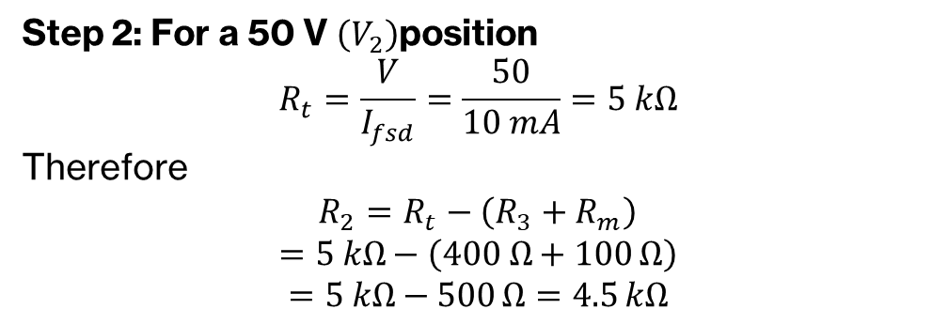
Multirange Voltmeter
A basic PMMC meter movement with an internal resistance of 100 Ω and a full-scale deflection of 10 mA into a multirange dc voltmeter with ranges from 0- 5 V,0- 50 Vand 0- 100 V. For figure 1, calculate the value of R₁, R₂ and R₃.

Slide 18
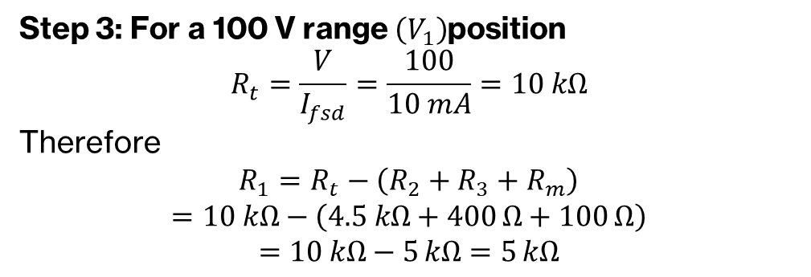
Multirange Voltmeter
A basic PMMC meter movement with an internal resistance of 100 Ω and a full-scale deflection of 10 mA into a multirange dc voltmeter with ranges from 0- 5 V,0- 50 Vand 0- 100 V. For figure 1, calculate the value of R₁, R₂ and R₃.

Slide 19
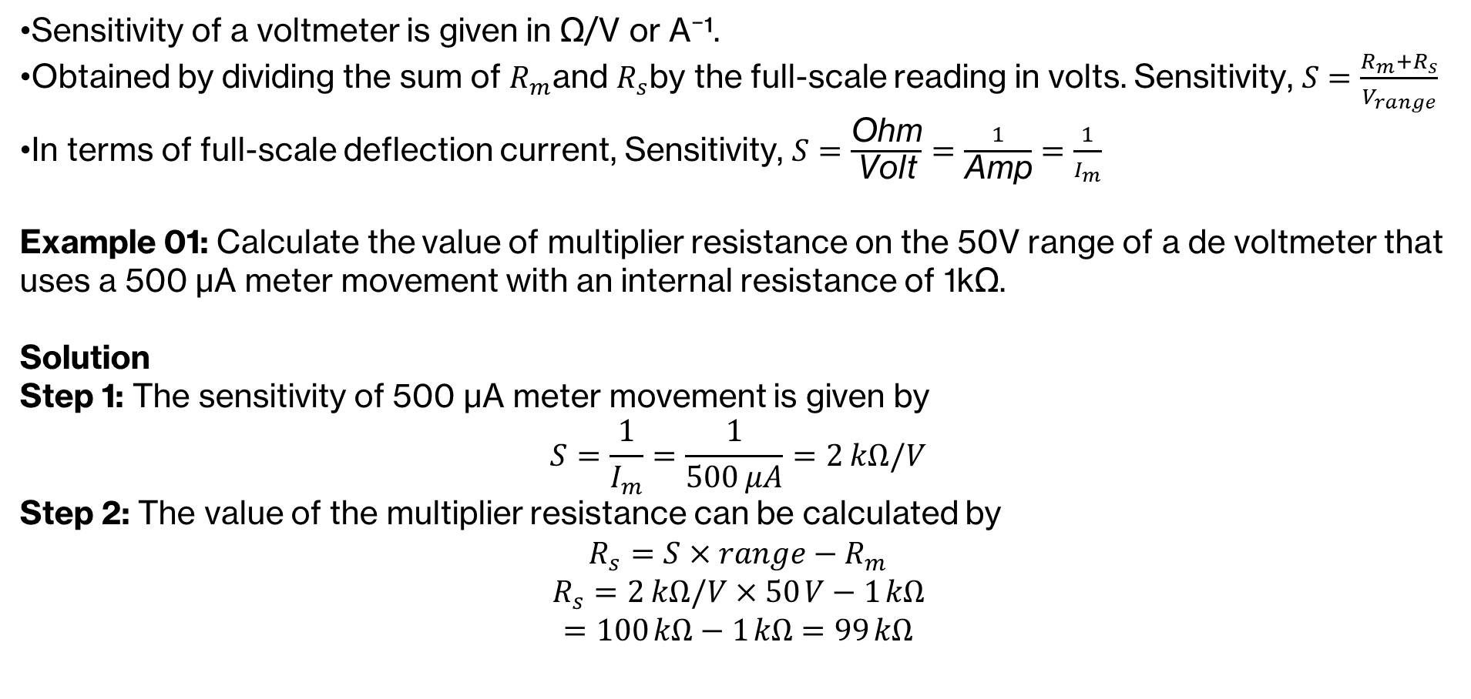
Voltmeter Sensitivity

Slide 20
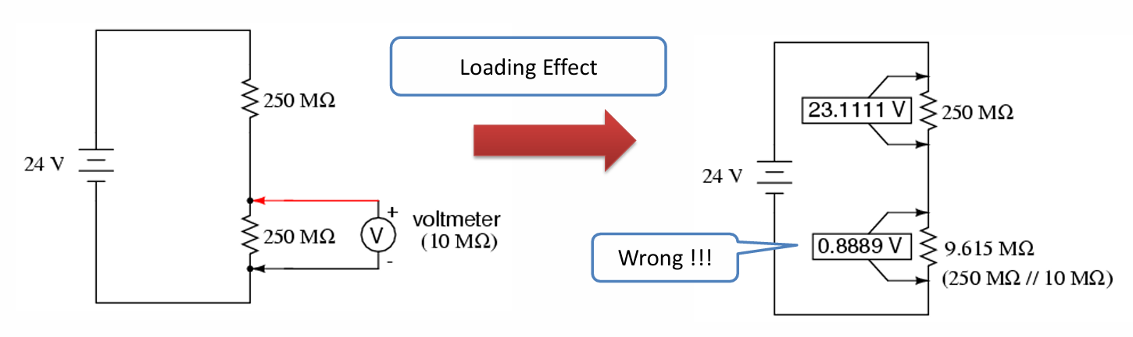
Loading Effect
Every meter impacts the circuit it is measuring to some extent.
While some impact is inevitable, it can be minimized through good meter design.
Voltmeters are always connected in parallel with the component under test.
A perfect voltmeter has infinite resistance, so that it draws no current from the circuit under test. However, perfect voltmeters only exist in the pages of textbooks, not in real life

Slide 21
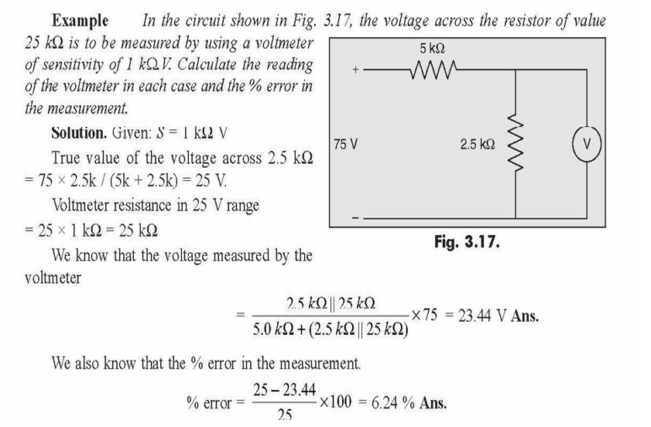
Voltmeter Sensitivity

Slide 22
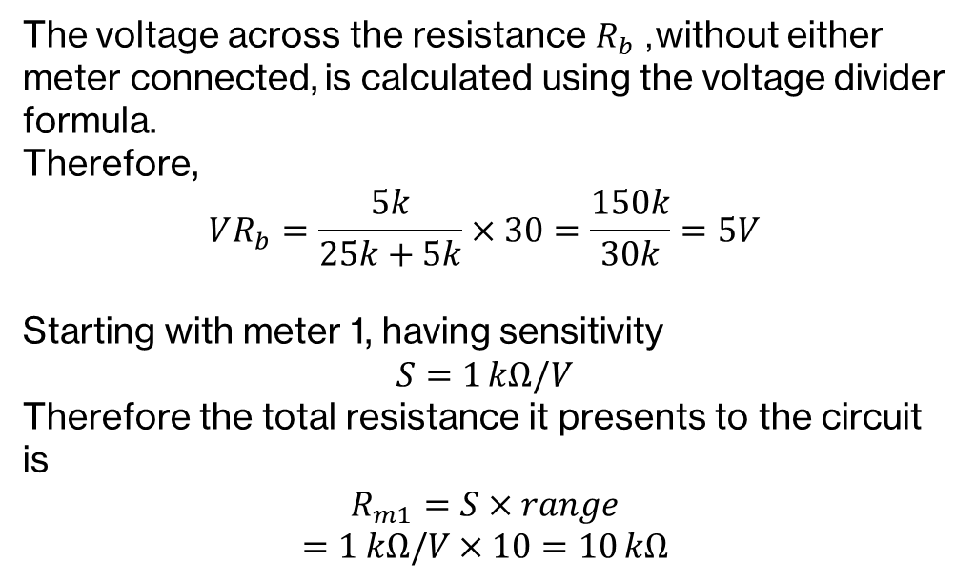
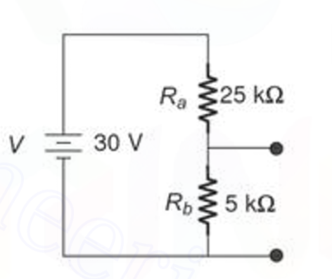
Voltmeter Sensitivity

Slide 23
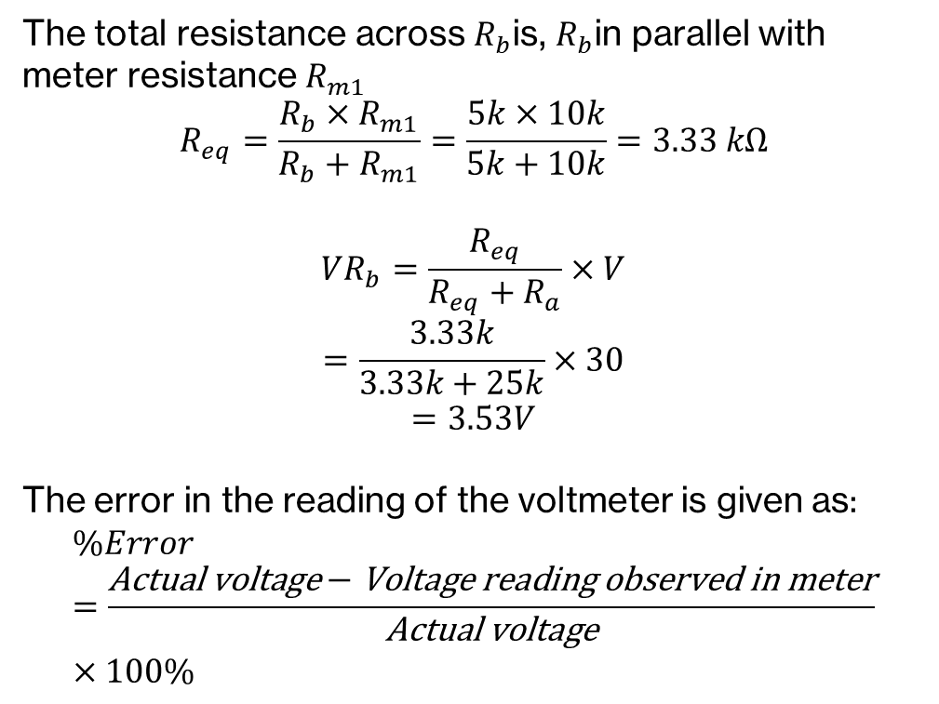
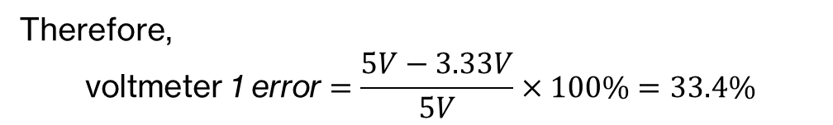
Voltmeter Sensitivity

Slide 24
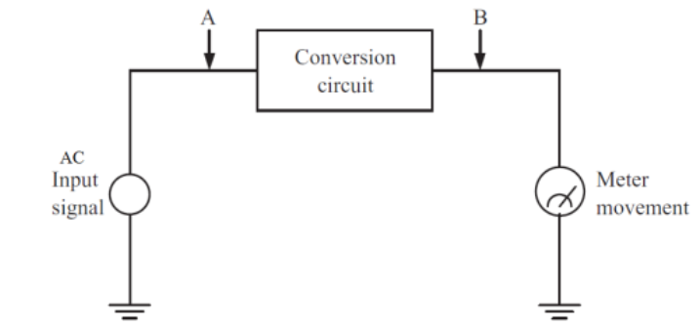
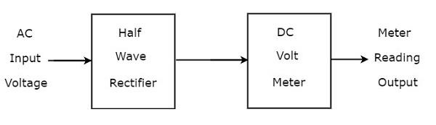
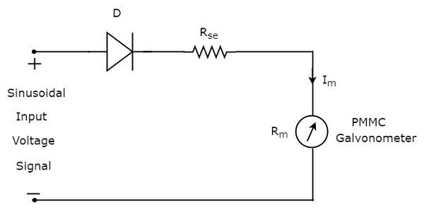
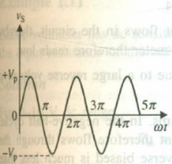
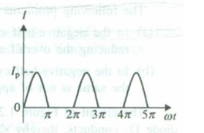
Rectifier-based AC Meters
Half-wave rectifier AC Meter:

Slide 25
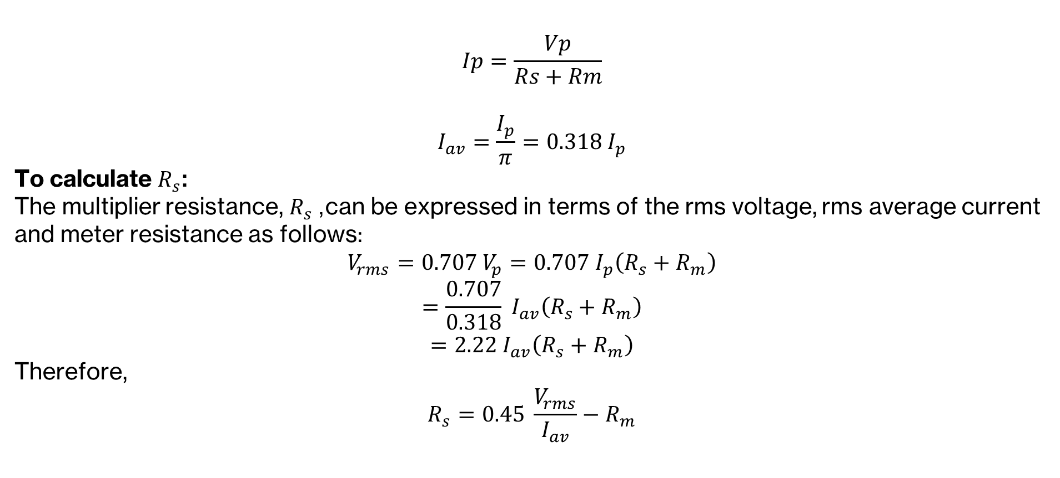
Rectifier-based AC Meters

Slide 26
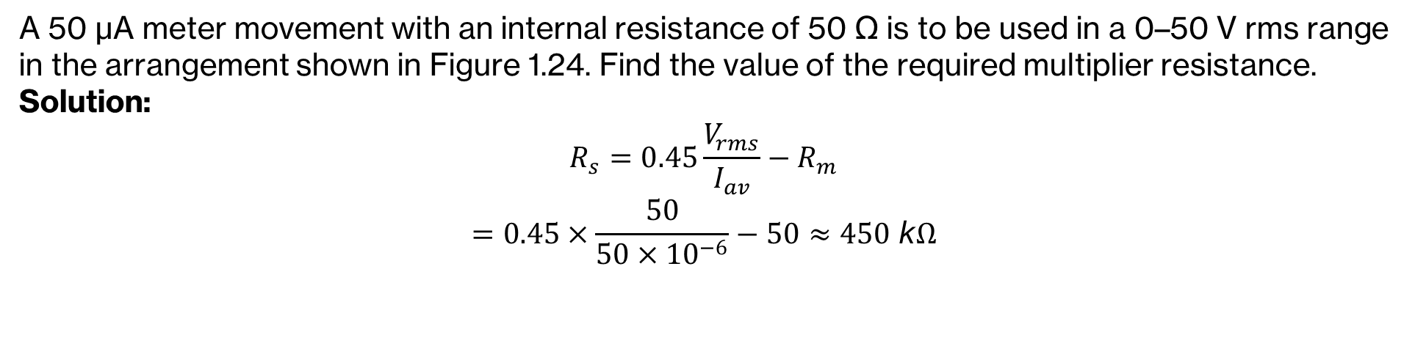
Rectifier-based AC Meters

